Slide 1
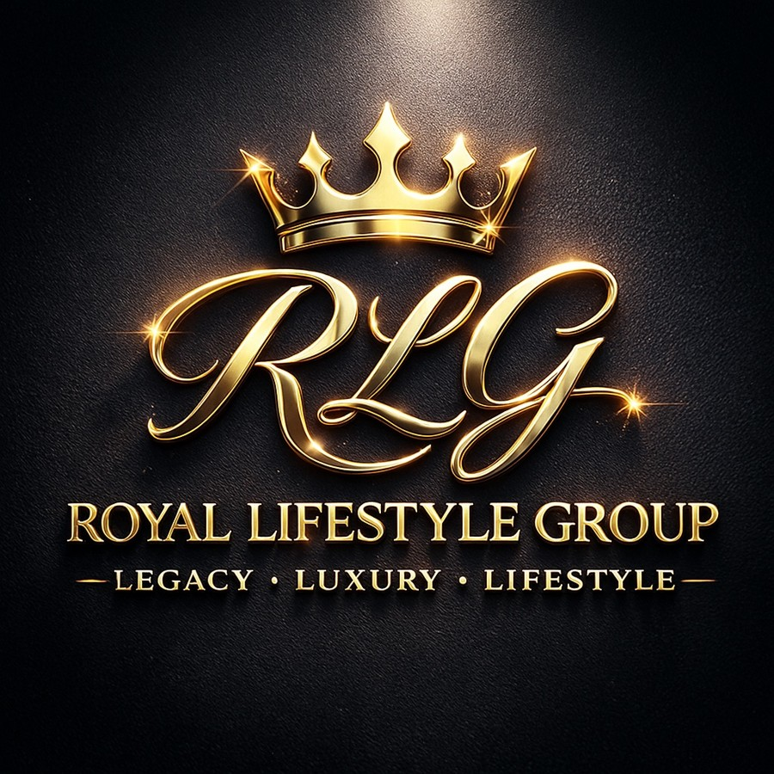
ROYAL LIFESTYLE GROUP™
LUXURY • LEGACY • LIFESTYLE
Invest in a Multi-Brand
Lifestyle Platform
Premium tobacco • Artisan Dominican coffee • Culture-driven branding
$1M
$2M
33.3%
Growth Capital Raise
Pre-Money Valuation
Investor Ownership
✓ BACKED BY $105,000 SBA CAPITAL
Lewis J. Lowe IV | Founder & CEO
investors@royallifestylegroup.com | (619) 818-5445

Slide 2
WHY NOW
The market timing has never been more favorable for RLG.
MARKET FORCES
RLG POSITIONING
Premium leaf wrap category estimated growing double-digits annually (management estimate)
Consumers shifting decisively toward natural leaf products
Gen Z + Millennial spend on lifestyle tobacco brands accelerating
Specialty coffee subscription market expanding rapidly
Social-commerce driving brand discovery — not retail shelf space
Cultural authenticity now commands premium pricing power
Dominican sourcing creates authentic differentiation — not a claim
Tobacco + coffee = diversified lifestyle platform, one supply chain
SBA financing validates operational viability to distributors
Product assets, trademarks, and packaging already complete
Lean team + outsourced manufacturing = capital-efficient scaling
Early-positioned premium Dominican leaf wrap brand with differentiated sourcing and lifestyle positioning
The window to enter premium tobacco lifestyle at this price point is NOW — before national distribution consolidates.

Slide 3

WHO WE ARE
ROYAL LIFESTYLE GROUP™ | LUXURY • LEGACY • LIFESTYLE
A multi-brand lifestyle platform built around Dominican craftsmanship and modern culture.
Royal Lifestyle Group™ ("RLG") is the consumer lifestyle platform of LJL Family Enterprises Inc., uniting premium tobacco, artisan coffee, and brand culture under one luxury umbrella. Headquartered in Prescott, Arizona with manufacturing in Santiago, Dominican Republic.
Platform Foundation
Brand Strategy
Arizona HQ, Dominican production, U.S. wholesale distribution strategy, and a portfolio of high-margin repeat-purchase consumer products.
One visual language across premium cigars, pre-cut leaf wraps, cigarillos, and artisan coffee — built for retail shelves and culture-driven marketing.

Slide 4
INVESTMENT HIGHLIGHTS
Why RLG Now — capital-efficient launch with product assets, SBA funding, and brand positioning ready.
🏆 Multi-Brand Platform
📦 Product Assets Built
Royal Flush®️, Leaf Cutz™, Poker Face®, and Las Caobas™ share one luxury lifestyle language across four product categories.
Packaging, flavor systems, product imagery, and launch positioning are ready for market execution — not a concept stage company.
🏛️ $105K SBA Capital
📈 Portfolio Upside
SBA-backed capitalization provides a de-risked foundation for production, marketing, and initial rollout to Arizona and California.
Multiple product categories create more than one path to revenue and long-term investor return across tobacco, coffee, and lifestyle.
Investor Thesis: RLG is not a single product launch — it is a scalable platform of high-margin repeat-purchase consumer products with wholesale distribution economics.

Slide 5
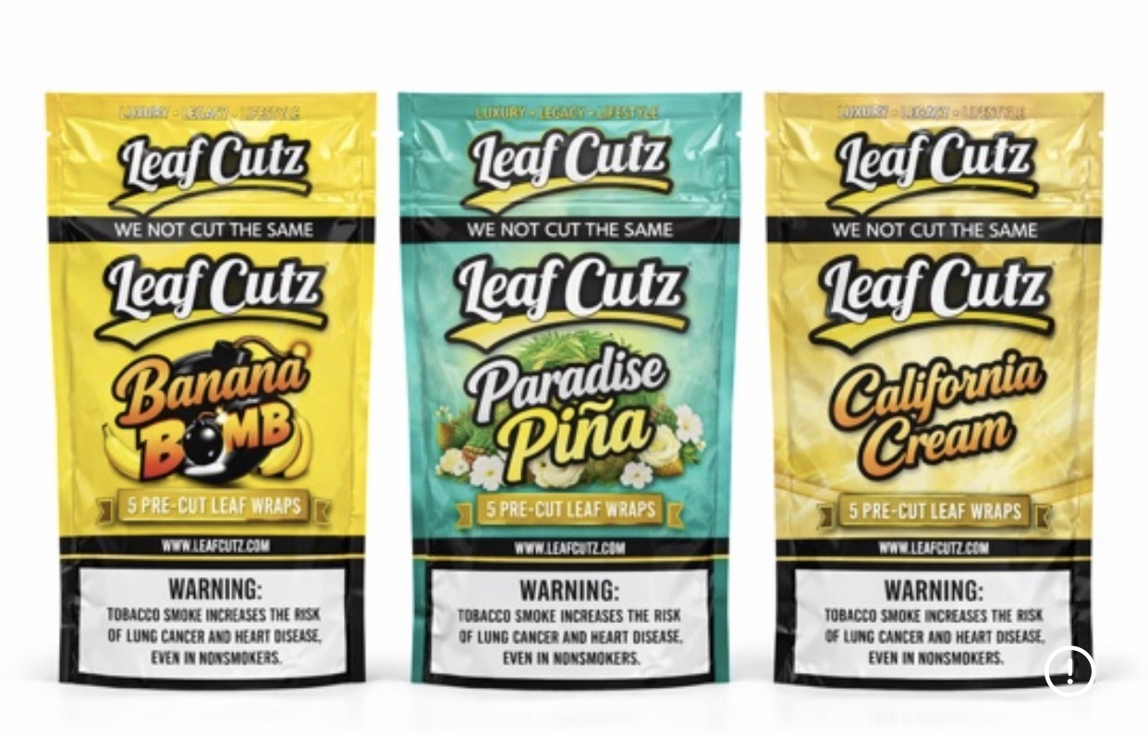
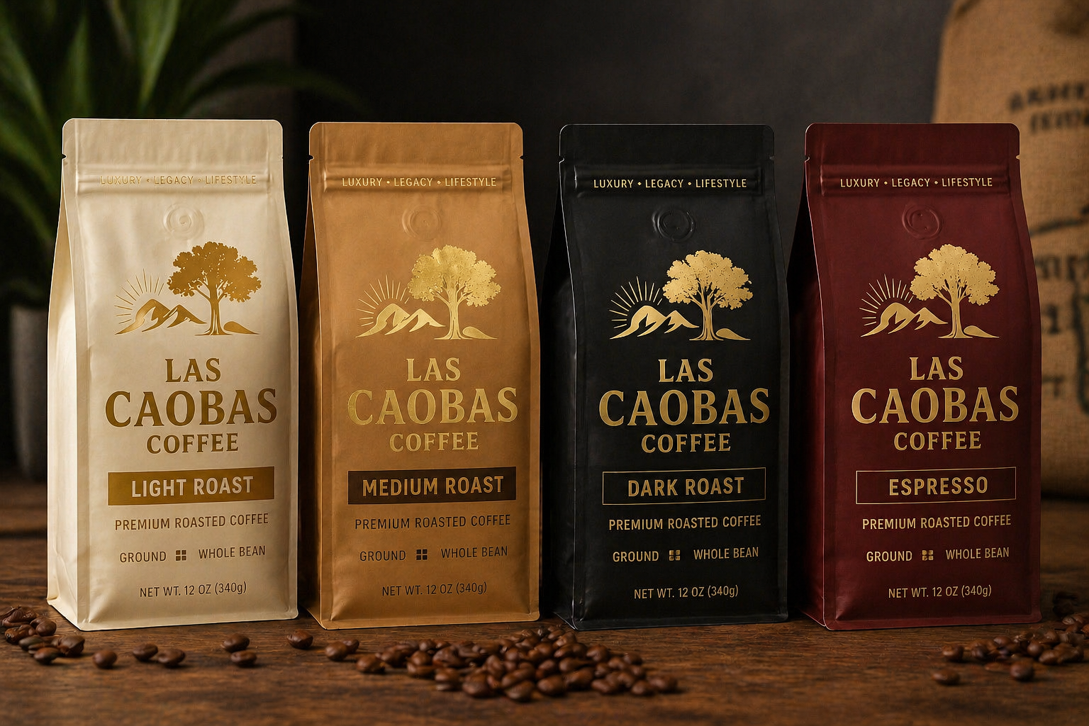
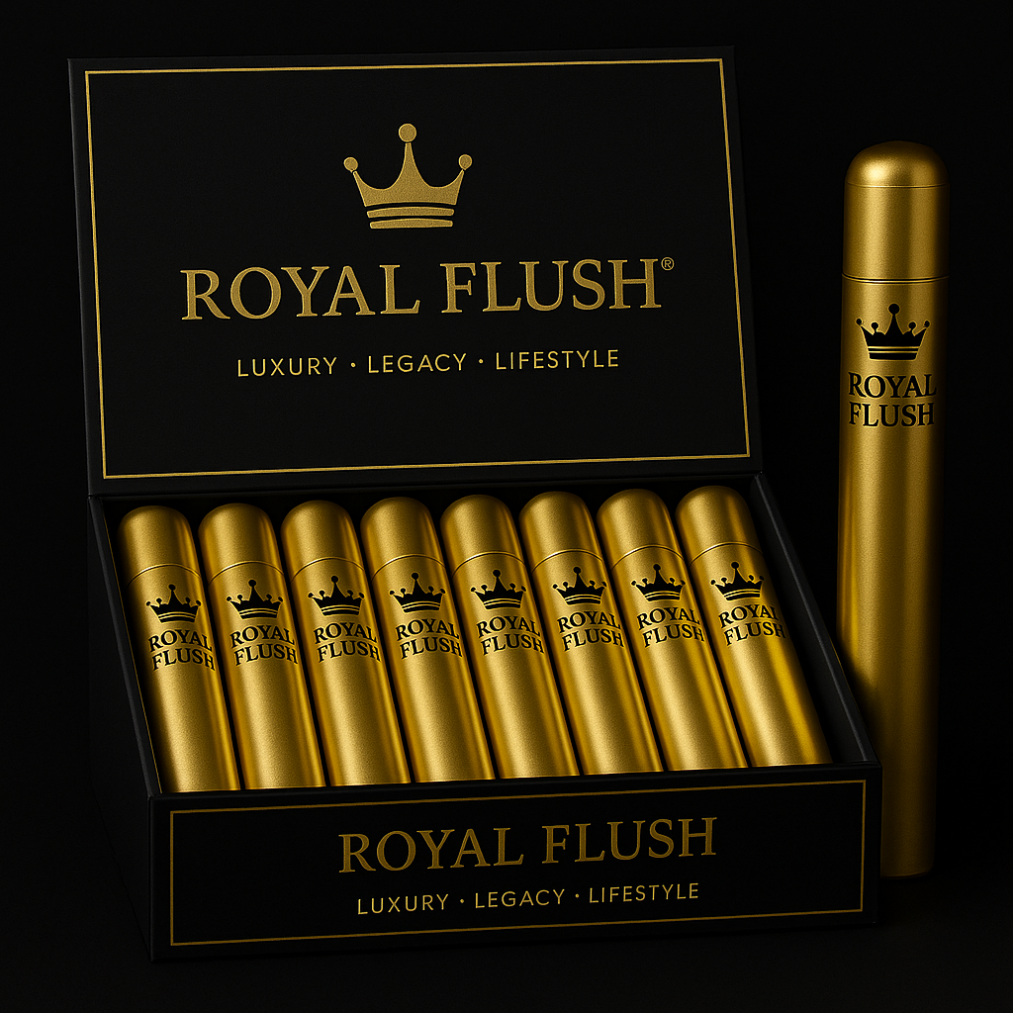
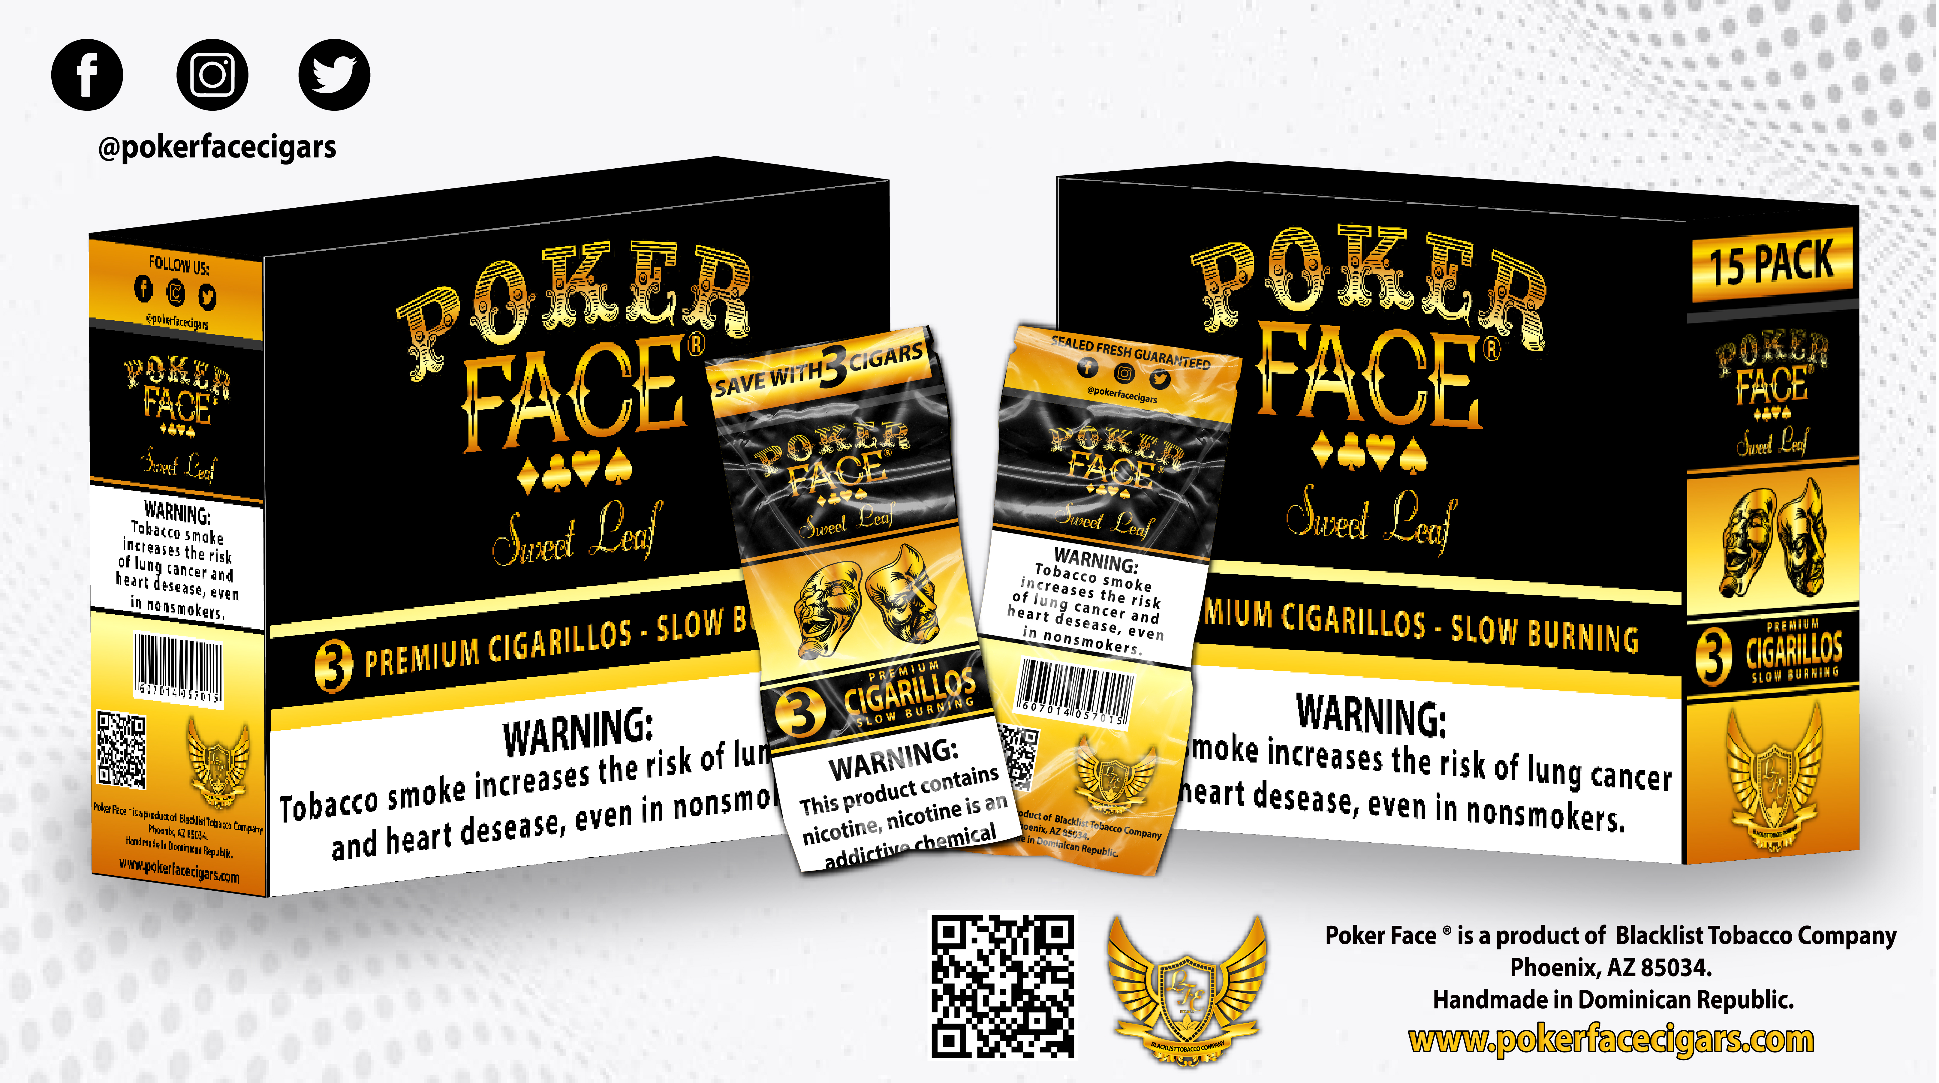
BRAND PORTFOLIO
One platform. Multiple revenue lanes.
PHASE 1
PHASE 1
PHASE 2
PHASE 2
Leaf Cutz™
Las Caobas™
Royal Flush®️
Poker Face®
VELOCITY ENGINE
ARTISAN COFFEE
FLAGSHIP LUXURY CIGAR
CIGARILLOS PLATFORM
Premium pre-cut leaf wraps for retail velocity and repeat purchase. Core launch revenue driver with distributor-ready packaging.
Dominican specialty coffee targeting DTC e-commerce, subscriptions, and premium gifting — a cleaner consumer lane outside tobacco.
Premium luxury cigar for lounges, casinos, golf clubs, and hospitality. The brand's halo product and margin story.
Cigarillo brand designed to expand the buyer basket alongside Leaf Cutz™ as wholesale relationships mature.
"WE NOT CUT THE SAME™"
Ritual & DTC Growth
Luxury • Legacy • Lifestyle
Expand the Buyer Basket

Slide 6
MARKET OPPORTUNITY
RLG operates at the intersection of premium tobacco, artisan coffee, and culture-driven lifestyle consumer products.
$50B+
$2.5B
$15M
TAM — Total Addressable Market
SAM — Serviceable Addressable Market
SOM — Serviceable Obtainable Market
Premium tobacco, wraps, cigars & specialty coffee
U.S. Southwest premium tobacco & specialty coffee
0.1% capture — Years 1–3 target
Consumer Categories
Initial Target Markets
Premium cigars and cigar lounges
Pre-cut leaf wraps and cigarillo alternatives
Specialty coffee and DTC subscriptions
Culture-driven lifestyle and future accessories
🌵 Arizona — Phase 1 Launch
🌴 California — Phase 1 Expansion
🌟 Florida — Phase 2 Growth
🍑 Georgia — Phase 2 Growth
Note: Market figures are illustrative. Management estimates based on industry research. RLG does not need national penetration to create meaningful revenue.

Slide 7
COMPETITIVE POSITIONING
Where Leaf Cutz™ wins — and why incumbents can't follow.
BRAND
LUXURY POSITION
DOM. SOURCING
LIFESTYLE BRAND
DTC POTENTIAL
REPEAT PURCHASE
Leaf Cutz™
✓ Premium
✓ Dominican
✓ Strong
✓ High
Strong Repeat
Backwoods
✗ Mass market
✗ None
Limited
✗ Low
Moderate
Dutch Masters
✗ Mass market
✗ None
✗ Minimal
✗ Low
High
LooseLeaf
Mid-range
✗ None
Moderate
Moderate
Moderate
Game / Garcia
Mid-range
✗ None
Limited
✗ Low
High
RLG's competitive moat: Authentic Dominican sourcing + luxury lifestyle positioning + high-margin DTC model = a category no incumbent currently owns.

Slide 8
DISTRIBUTION MODEL
Wholesale tobacco + Direct-to-consumer coffee = balanced launch model
Tobacco
Coffee
Lifestyle
Distributor / Wholesale
DTC / E-Commerce
Brand Activation
Distributor / wholesale pathway
E-commerce / direct-to-consumer
Brand partnerships
Retail shelf placement
Subscription coffee bundles
Music & culture activation
Repeat purchase velocity
Corporate gifting packages
Future apparel line
Display box merchandising
Cross-platform brand promotion
Premium lifestyle positioning
Long-Term Target: Net Margins Exceeding 30%
Through premium pricing, scalable wholesale distribution, repeat-purchase consumer behavior, and disciplined operational growth.

Slide 9
UNIT ECONOMICS & MANUFACTURING COSTS
Ex-factory cost structure from Dominican Republic manufacturing partners — strong margin architecture from day one.
Leaf Cutz™ — VELOCITY ENGINE
Royal Flush®️ — FLAGSHIP LUXURY CIGAR
$0.85 – $1.08
$2.99 MSRP
$1.82 – $2.65
Ex-Factory Cost / pouch
Target Retail Price
Ex-Factory Cost / cigar
COST COMPONENT BREAKDOWN
Positioned for premium lounges, casinos, and hospitality. Planned $7–$15 retail per cigar.
Pre-cut tobacco leaf material
$0.22 – $0.40
Mylar pouch packaging
$0.09 – $0.12
Poker Face® — CIGARILLOS PLATFORM
Display box allocation
$0.05 – $0.12
$0.28 – $0.62
Labor + cutting + moisture control
$0.12 – $0.20
Ex-Factory Cost / pack
Branding / printing
$0.08 – $0.15
Mass-market cigarillo category with highly competitive manufacturing costs. Expands buyer basket alongside Leaf Cutz™ at Phase 2.
Factory margin + overhead
$0.15 – $0.25
TARGET EX-FACTORY TOTAL
$0.85 – $1.08
Margin thesis: Low ex-factory costs across all brands support 60–75%+ gross margins at target retail pricing.

Slide 10
DISTRIBUTOR & REVENUE ECONOMICS
Operational assumptions underlying Year-1 projections of $425K combined revenue.
LEAF CUTZ™ — WHOLESALE DISTRIBUTION MODEL
LAS CAOBAS COFFEE™ — DTC SUBSCRIPTION MODEL
25–50
8–15
$1.75
~300 subs
$55
60%
Retail Doors (Yr 1)
Units / Store / Mo
Avg Wholesale
Yr 1 Target
Avg Sub/Month
DTC Margin
AZ + CA target
Conservative
$1.65–$1.80/pouch
Range: 200–500
$45–$65
vs 35–40% wholesale
Projected 50-door pilot revenue:
~$150,000+ / Year 1
Recurring revenue (300 × $55):
~$16,500 / month
Est. monthly revenue contribution per retail door:
Conservative sell-through assumption
Bag sales ($18–$24 MSRP):
Additional DTC upside
Est. gross margin at wholesale:
~35–53% per pouch
Year-1 annualized projection:
~$200,000+
COMBINED PHASE 1 YEAR-1 TARGET: $425,000 | Conservative ramp | No Phase 2 brands or licensing revenue included

Slide 11
5-YEAR FINANCIAL PROJECTIONS
Illustrative ramp based on distributor onboarding, retail placement, repeat-purchase cycles, and Las Caobas™ DTC growth.
Year
Revenue
Net Profit
Margin
2026
$425K
$110K
26%
2027
$1.1M
$308K
28%
2028
$2.2M
$660K
30%
2029
$3.8M
$1.22M
32%
2030
$5.5M
$1.82M
33%
5-Year Revenue CAGR: 89%
Net Margins Expand to 33% by 2030
◆ Break-Even: Year 1
DSCR > 1.25x | SBA-backed
These projections are illustrative only and are not guarantees of future performance. SBA-backed capital structure reduces investor dilution risk.

Slide 12
USE OF FUNDS — $1M GROWTH RAISE
Capital is designed to accelerate inventory, distribution, marketing, and working capital.
TOTAL PHASE 1 CAPITAL — $135,000
$1M INVESTOR RAISE — PLANNED ALLOCATION
Initial Inventory
$38,000
28.1%
Inventory & Manufacturing Scale
35% · $350K
Marketing & Brand Launch
$25,000
18.5%
Contingency Buffer
$20,000
14.8%
National Marketing & Trade Shows
25% · $250K
Working Capital Reserve
$15,000
11.1%
Distribution & Sales Support
20% · $200K
Logistics / Freight / Customs
$10,000
7.4%
Operations / Administration
$8,000
5.9%
E-Commerce & Content Growth
10% · $100K
Compliance / Legal / Licensing
$8,000
5.9%
Trade Shows / Travel
$7,000
5.2%
Working Capital Reserve
10% · $100K
Website / E-Commerce
$4,000
3.0%

Slide 13
INVESTMENT TERMS & VALUATION
Seeking $1M growth capital at a proposed $2M pre-money valuation.
$2,000,000
$1,000,000
$3,000,000
Pre-Money Valuation
Growth Capital Raise
Post-Money Valuation
~33.3% Investor Ownership Offered
Assuming the full $1M raise is completed at the $2M pre-money valuation
SBA Loan Foundation
Investor Takeaway
Loan Amount: $105,000
Interest Rate: ~11% | Term: 10 Years
Monthly Payment: ~$1,445 | Annual Debt Service: ~$17,340
RLG is deploying SBA capital efficiently as a de-risked foundation. Investor capital accelerates the growth layer — not the startup layer.

Slide 14
OWNERSHIP STRUCTURE
Post-$1M Raise at $2M Pre-Money Valuation | LJL Family Enterprises Inc. d/b/a Royal Lifestyle Group™
SHAREHOLDER
PRE-MONEY
POST-MONEY
Lewis J. Lowe IV (Founder & CEO)
~97%
~65%
Carolyn Lowe (Owner / $30K equity)
~3%
~2%
Angel Investors (New — $1M Raise)
—
~33%
TOTAL
100%
100%
DEAL TERMS
COMPANY DETAILS
Pre-Money Valuation:
$2,000,000
Legal Entity:
LJL Family Enterprises Inc. (AZ C-Corp)
Capital Raise:
$1,000,000
EIN:
87-4410605
Post-Money Valuation:
$3,000,000
Common Authorized:
10,200,000 shares
Investor Ownership:
~33%
Preferred Authorized:
9,800,000 shares
Security Type:
Common Equity
Convertibles/Warrants:
None currently outstanding
Full capitalization table, share ledger, and subscription documentation available to qualified investors upon request.

Slide 15
18-MONTH EXECUTION PLAN
What happens after capital is deployed — milestone by milestone.
MONTHS 1–6
MONTHS 6–12
MONTHS 12–18
Foundation & Launch
Scale & Optimize
Expand & Launch Phase 2
Launch Leaf Cutz™ in AZ + CA retail
Secure first 25+ retail accounts
Build Las Caobas DTC coffee platform
Attend TPE + CHAMPS trade shows
Activate influencer launch campaign
Complete SBA deployment to inventory
Achieve first distributor partnership
Expand distributor network — 3+ regional
Launch Las Caobas coffee subscription
Increase inventory turns + reorder cycles
Grow social following to 50K+ combined
Achieve break-even on Leaf Cutz™ ops
Begin Royal Flush®️ pre-production
Pursue national C-store placement
Enter FL + GA markets
Launch Royal Flush®️ premium cigars
Scale national influencer program
Pursue Series A at higher valuation
Begin Poker Face® distribution
Target $1.1M annual run rate
Explore national chain placement
Investor capital converts directly into measurable market milestones — not overhead.

Slide 16
TRACTION & PROOF POINTS
Momentum already built — capital accelerates what's already in motion.
✓ ALREADY COMPLETED
➤ CURRENTLY UNDERWAY
SBA loan approved and funded — $105,000
Dominican Republic manufacturing relationships active
Full product packaging + brand identity complete
Leaf Cutz™ flavors: Banana Bomb, Paradise Piña, California Cream
Las Caobas Coffee™ — 4 SKUs ready (Light, Medium, Dark, Espresso)
Domains, trademarks, and brand assets secured
Royal Flush®️ + Poker Face® product prototypes complete
Owner equity committed — $30,000 deployed
Distributor outreach — AZ + CA regional contacts
Trade show registration — TPE 2026
E-commerce platform build (Shopify)
Influencer identification + outreach underway
Initial retail account conversations open
Investor deck + memo distributed to network
Social media brand channels established
Subscription coffee waitlist building
This is not a concept. Products exist. Supply chain is live. Capital accelerates distribution.

Slide 17
ILLUSTRATIVE INVESTOR UPSIDE
Scenarios show how equity value could scale with future company valuation.
Base Case
Growth Case
Scale Case
Company Valuation
Company Valuation
Company Valuation
$10 Million
$25 Million
$50 Million
~5% stake = $500,000
~5% stake = $1,250,000
~5% stake = $2,500,000
~33.3% stake = $3.33M
~33.3% stake = $8.33M
~33.3% stake = $16.65M
National distributor expansion
Retail store penetration
E-commerce growth
Premium brand positioning
National distributor expansion
Retail store penetration
E-commerce growth
Premium brand positioning
National distributor expansion
Retail store penetration
E-commerce growth
Premium brand positioning
Important: These figures are illustrative discussion examples only and are not guarantees of future performance or investment returns. Exit pathways include strategic acquisition, distributor buyout, lifestyle merger, DTC dividend, and national licensing.

Slide 18
CAPITAL-EFFICIENT GROWTH MODEL
High-margin repeat-purchase consumer products with lean operational architecture.
🏭 Dominican Manufacturing
📦 Asset-Light Inventory
💰 High Gross Margins
Outsourced production — zero CapEx, zero factory overhead. Manufacturing scales with demand.
Lean SKU strategy. High-velocity items first. Inventory turns funded from revenue, not equity.
40–72% gross margins across brands. DTC channel reaches 65–70%+ margin. Wholesale still 35–53%.
🔁 Repeat-Purchase Categories
📋 Lean Team Structure
🏛️ SBA-Backed Foundation
Tobacco wraps and specialty coffee are consumed daily. Built-in repurchase velocity without re-acquisition cost.
Founder-led with outsourced ops. Capital goes to inventory, marketing, and distribution — not payroll.
$105K institutional debt reduces equity dilution. Lender-validated plan. Debt serviced from Year-1 revenue.
Result: A $135K total investment launching a 4-brand portfolio with 40–72% margins and repeat-purchase economics.

Slide 19
EXIT & RETURN PATHWAYS
Multiple routes to investor liquidity — not dependent on any single outcome.
01
Strategic Tobacco Acquisition
Major tobacco companies (Altria, Imperial Brands, Standard General) actively acquire premium lifestyle brands with proven distribution.
02
Regional Distributor Buyout
As distribution matures across AZ/CA/FL/GA, strategic regional buyers may acquire the distribution rights and brand equity.
03
Lifestyle Portfolio Merger
RLG's multi-brand platform (tobacco + coffee + lifestyle) positions it as a compelling acquisition target for lifestyle conglomerates.
04
DTC Recurring Revenue + Dividend
Las Caobas Coffee™ subscription creates predictable cash flow that could support a dividend distribution model for long-term investors.
05
National Licensing & Royalty
Brand licensing for Leaf Cutz™ and Royal Flush®️ creates royalty income streams without additional capital deployment.
Comparable exits in premium tobacco lifestyle: $10M–$75M range. Early investors at $2M pre-money capture maximum upside.

Slide 20
GROWTH ROADMAP
Confident, phased expansion — capital discipline first, then scale.
PHASE 1
2026–2027
PHASE 2
2027–2028
PHASE 3
2029–2030
Arizona + California
Florida + Georgia
National Scale
Launch Leaf Cutz™ and Las Caobas™
Initial distributor outreach
Online presence and DTC e-commerce
Trade show participation
Revenue target: $425K → $1.1M
Distributor expansion
Launch Royal Flush®️ premium cigars
Culture-driven brand activation
Subscription growth for Las Caobas™
Revenue target: $1.1M → $2.2M
Retail velocity across major markets
Broader wholesale distribution network
Poker Face® cigarillo platform launch
Brand extension potential
Revenue target: $3.8M → $5.5M

Slide 21
LEADERSHIP & NEXT STEPS
The team behind Royal Lifestyle Group™ and how to connect.
LL
Lewis J. Lowe IV
ML
Magaly Lowe
Founder & Managing Director
Operations Director
15+ years in business development and brand strategy. Architect of the RLG portfolio — from Dominican manufacturing relationships to multi-brand go-to-market execution. Leads investor relations, distribution strategy, and all executive decisions.
10+ years operational leadership. Manages end-to-end supply chain from Dominican Republic factories to U.S. distribution. Oversees logistics, compliance, inventory management, and day-to-day execution across all RLG brands.
Why Invest in RLG Now?
SBA-backed foundation de-risks the startup phase
Proven Dominican manufacturing relationships established
Product assets and brand identity already built
Lean launch strategy maximizes capital efficiency
Multi-brand portfolio creates multiple revenue paths
Early investors capture maximum upside potential
investors@royallifestylegroup.com | (619) 818-5445 | Lewis J. Lowe IV, Founder & CEO

